Slide 1
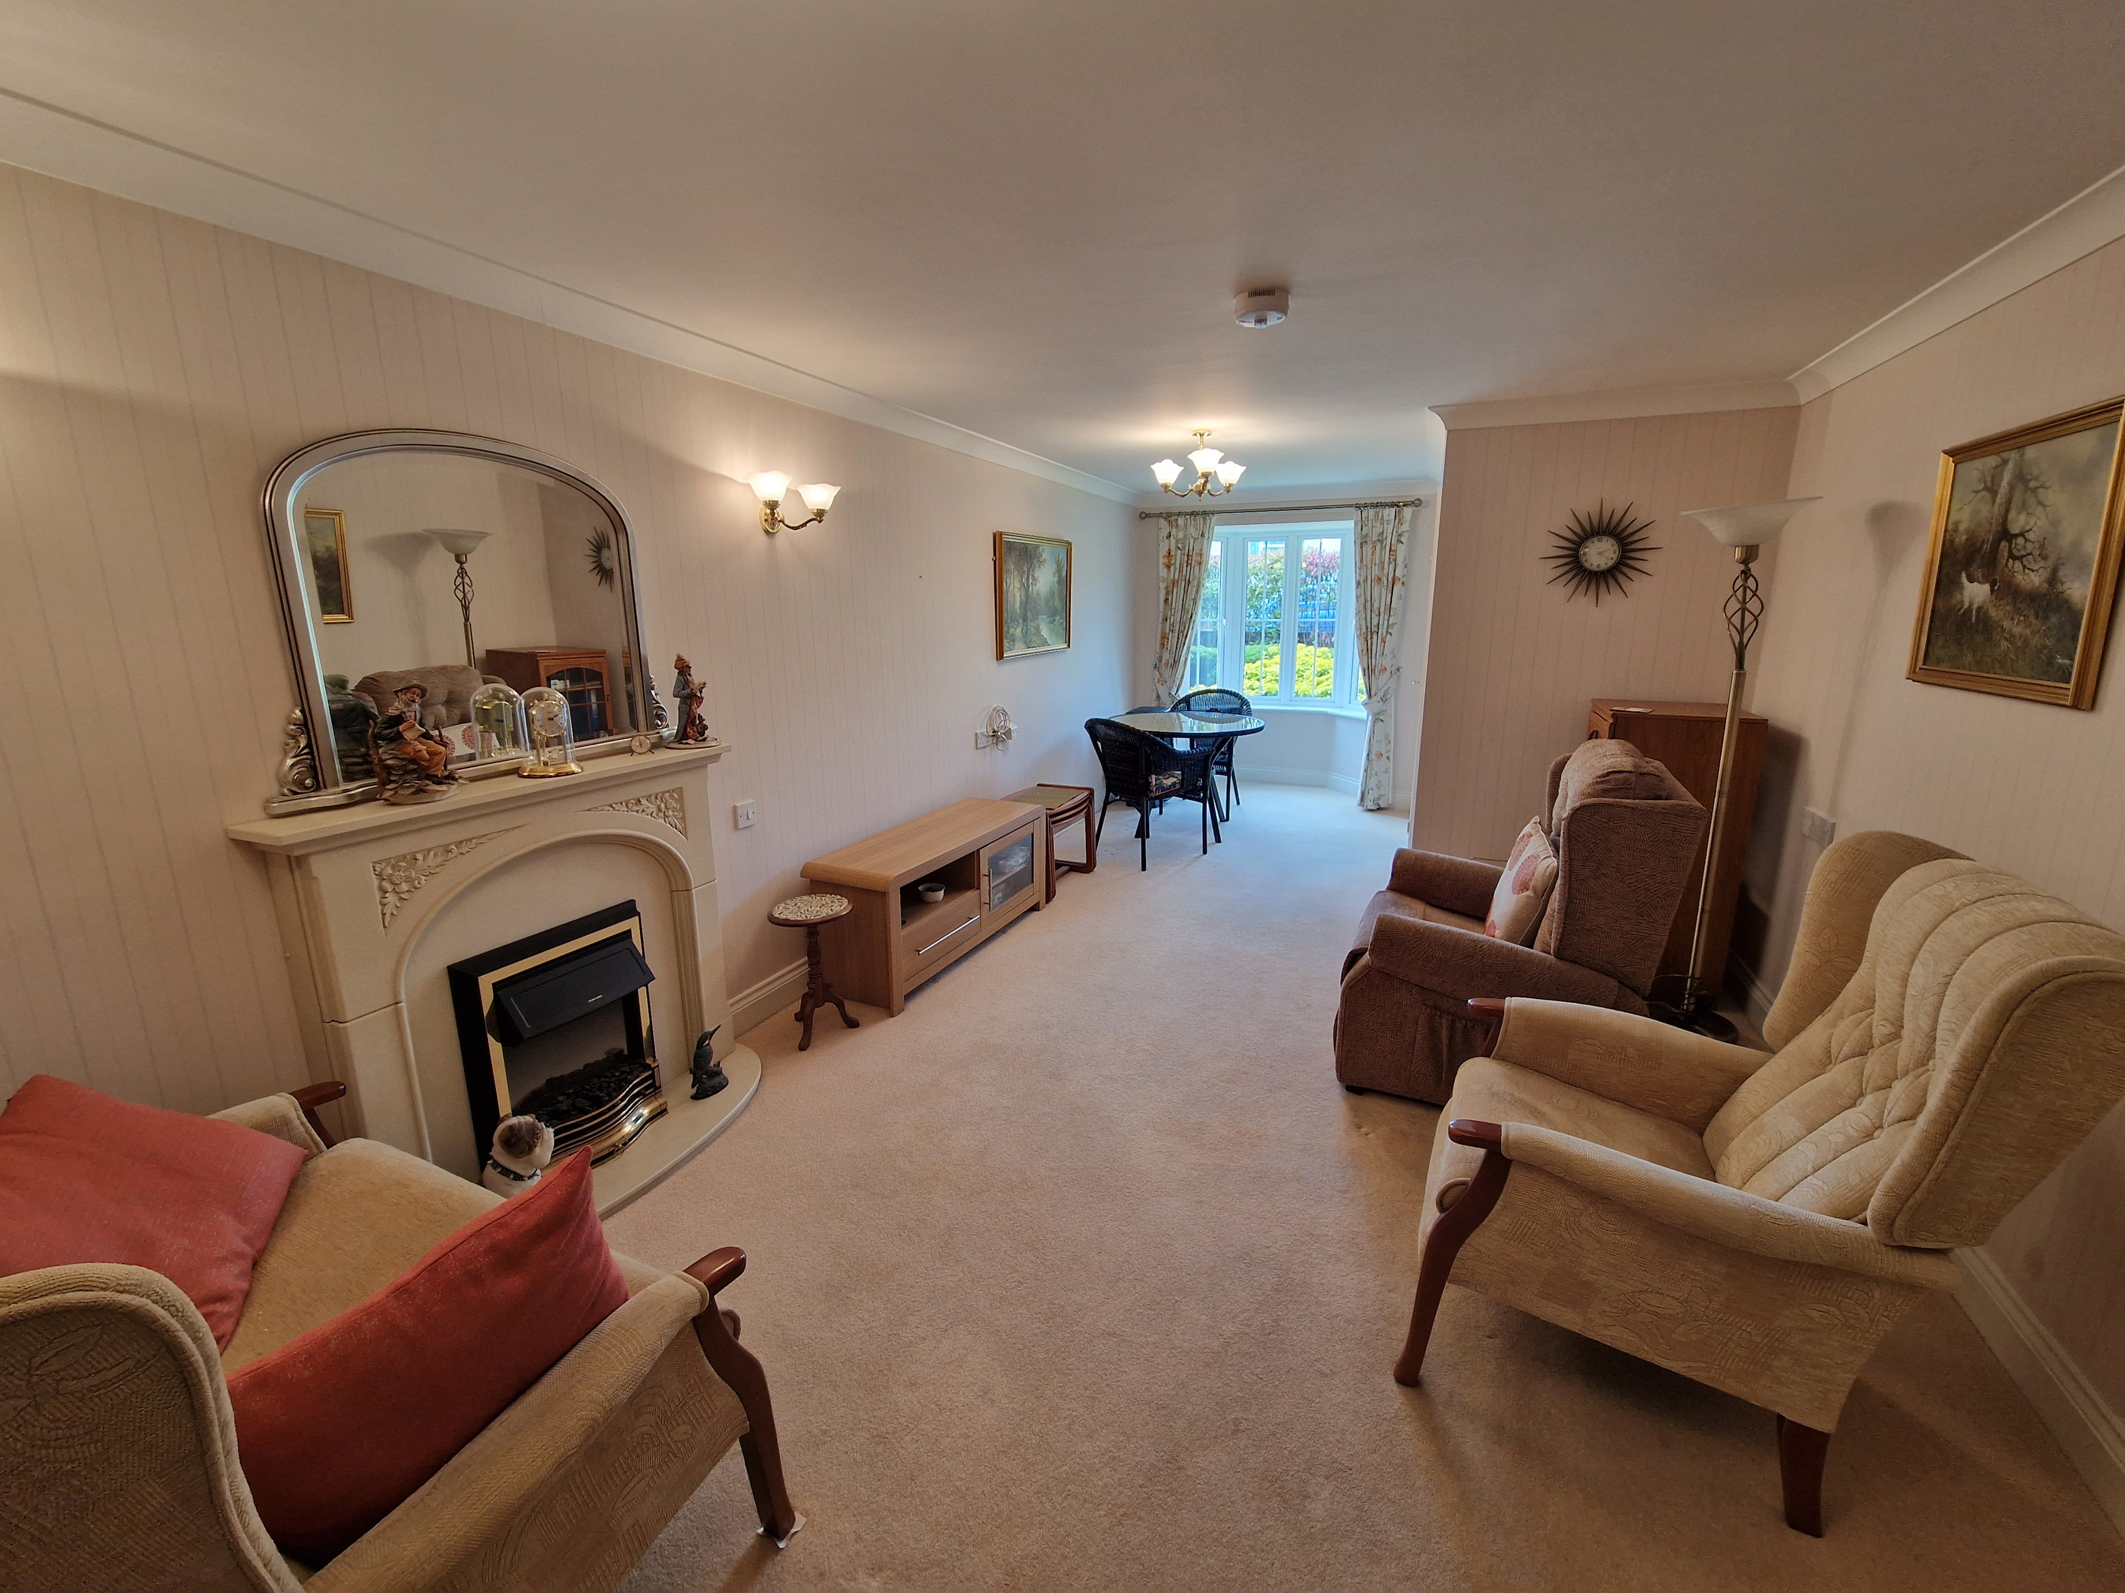
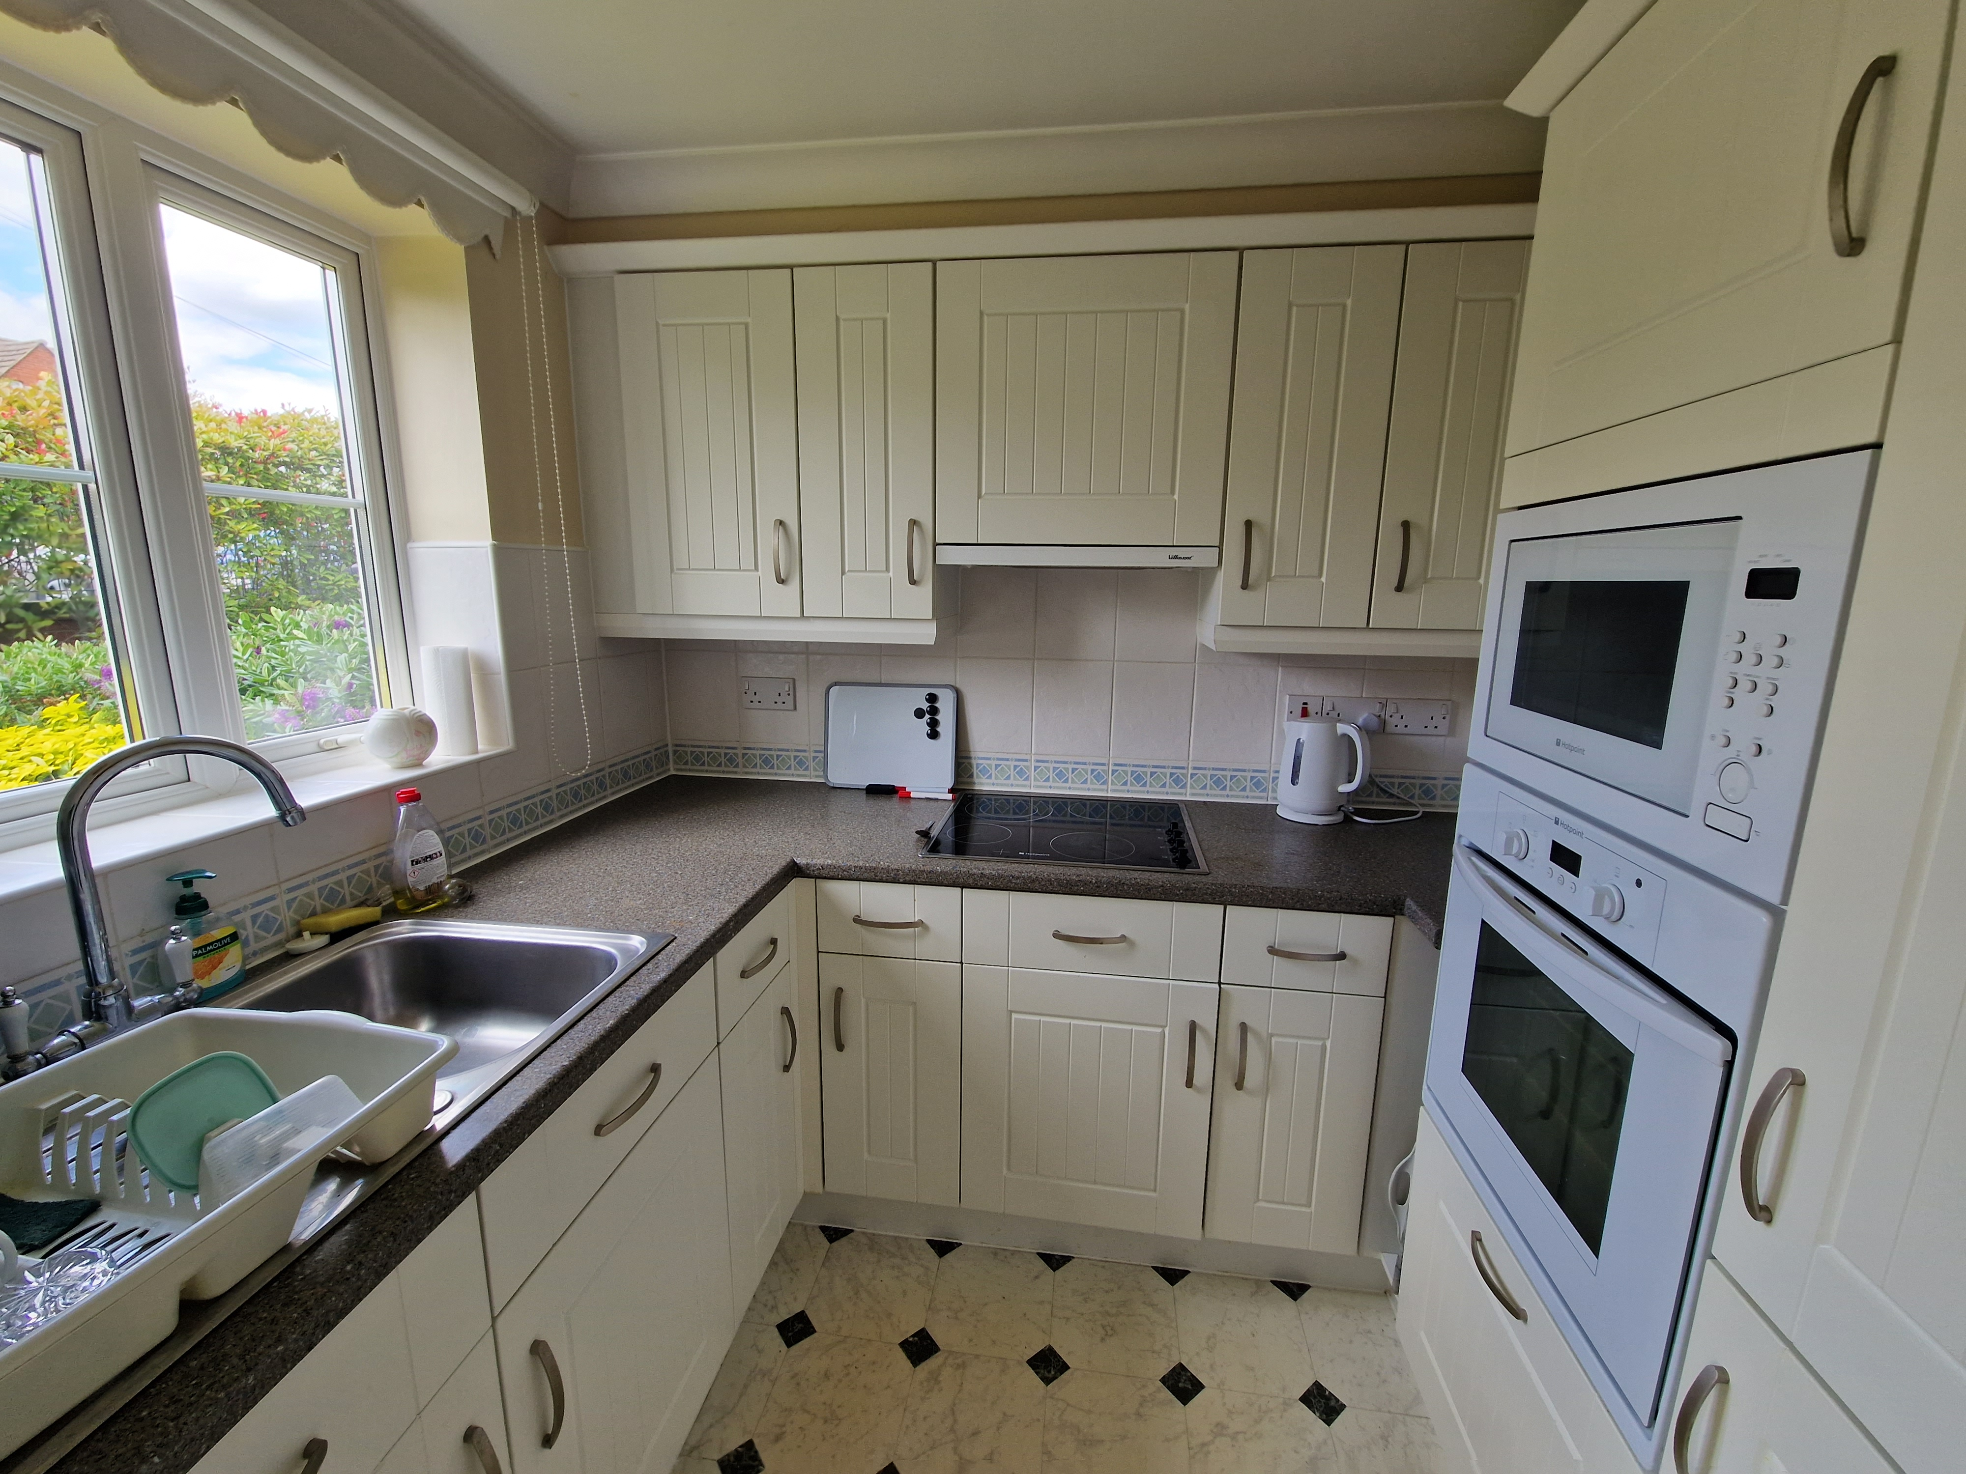
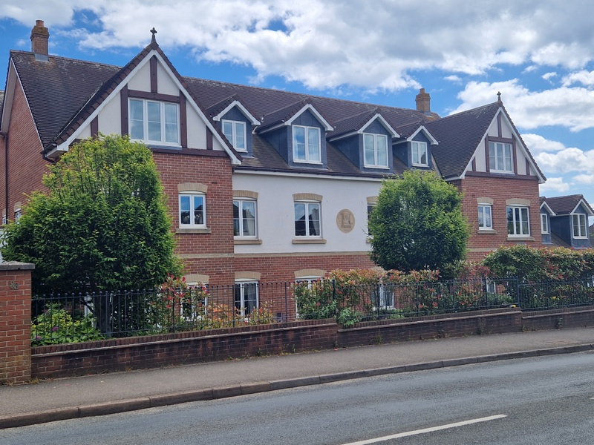
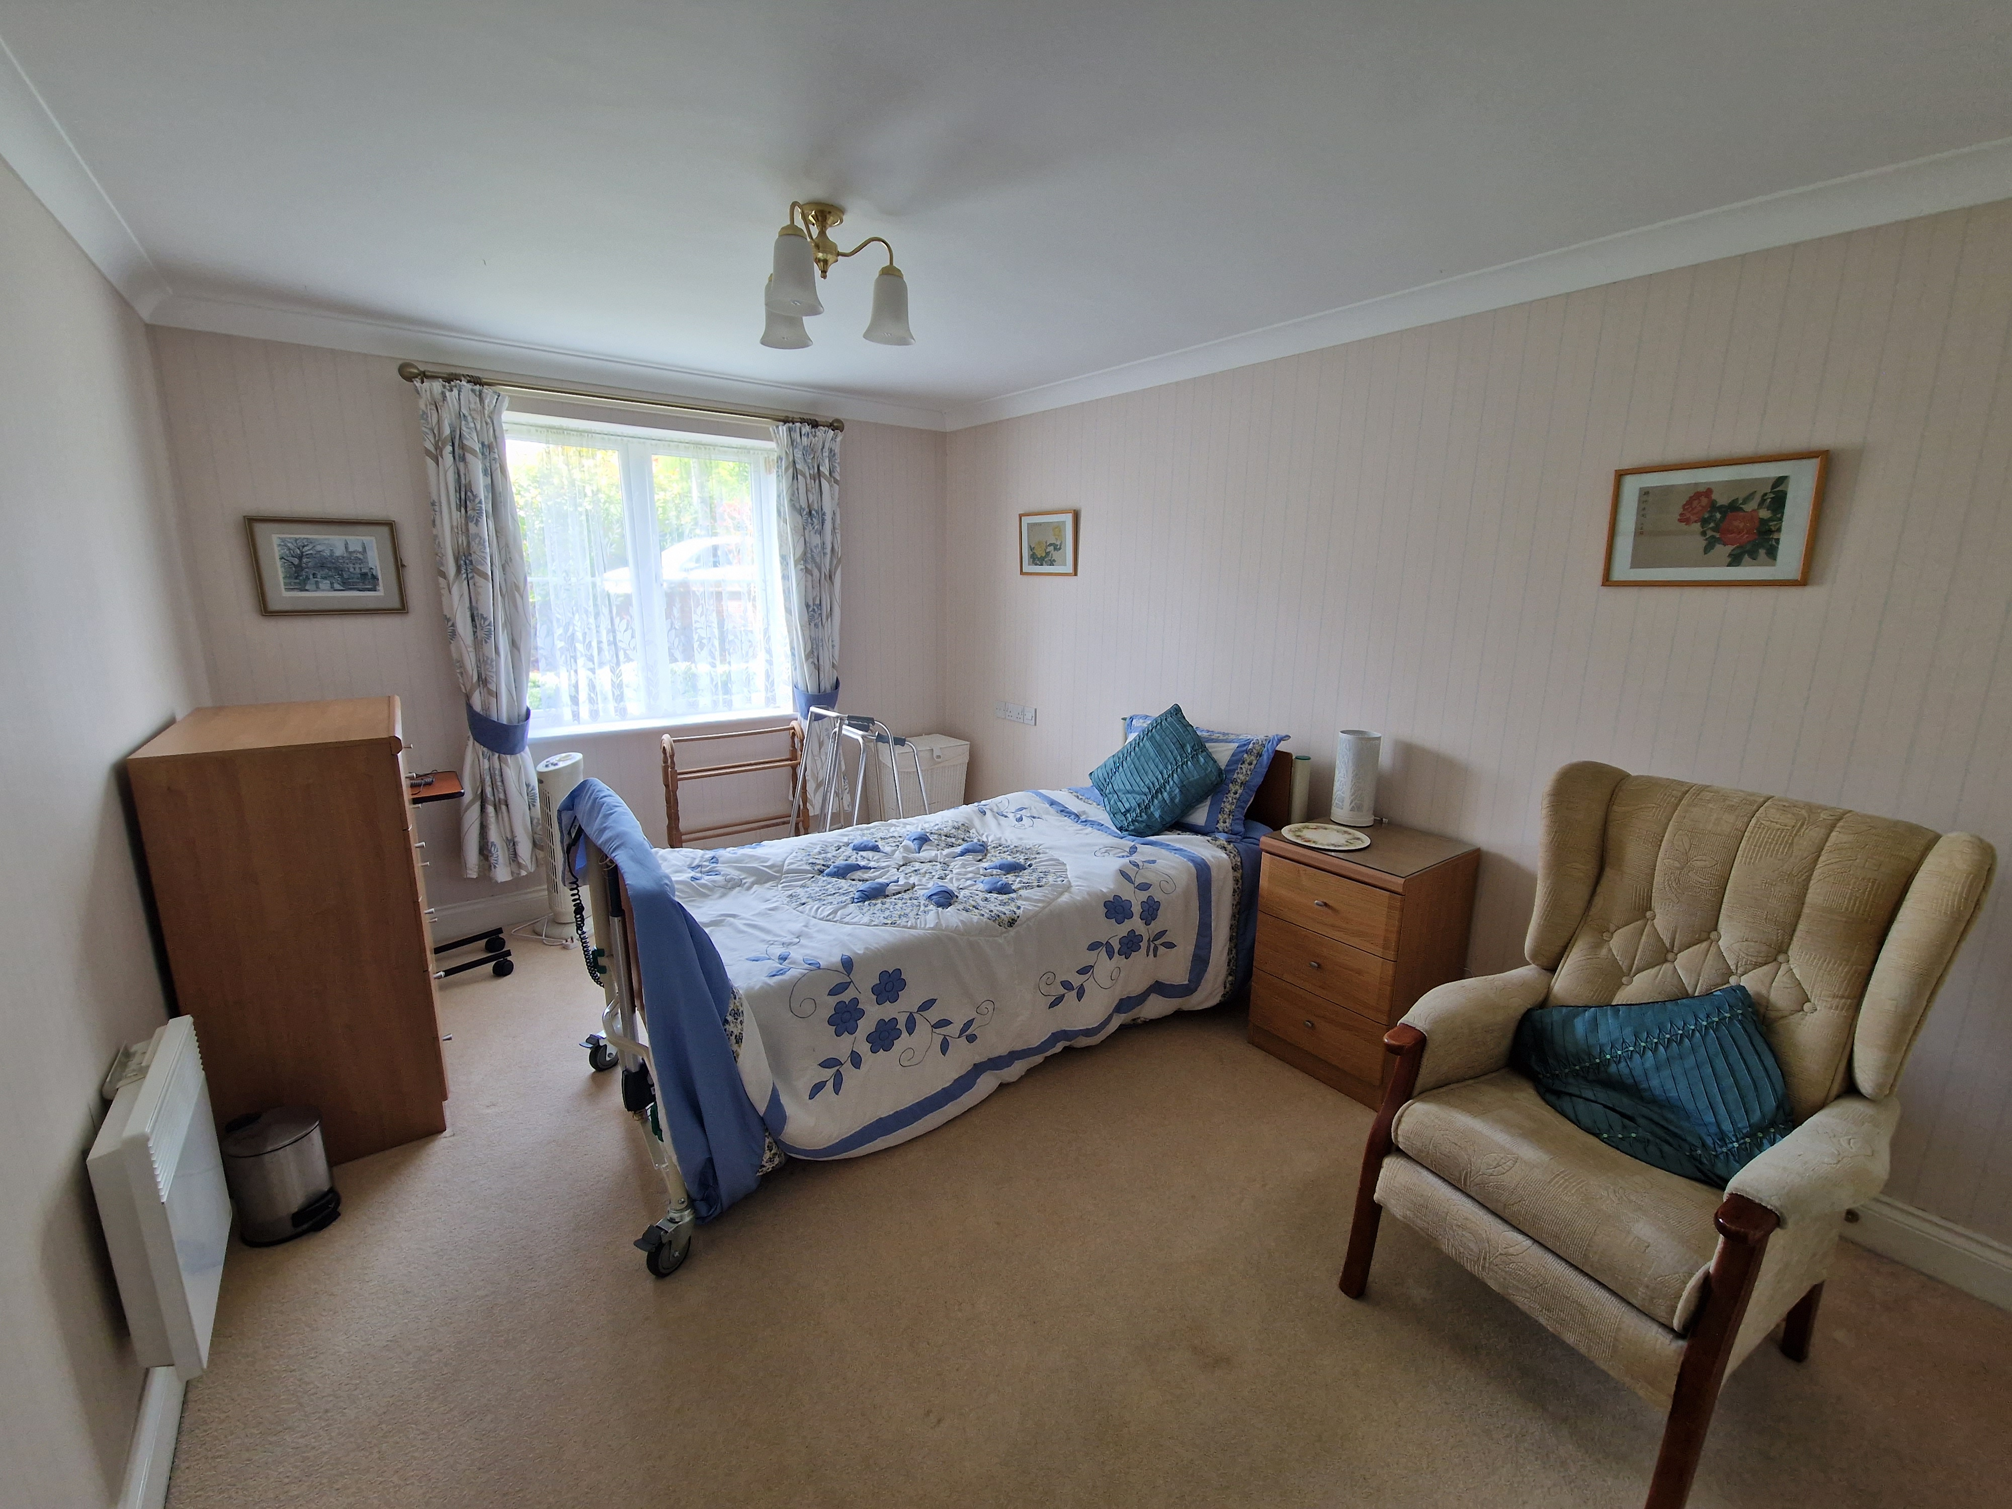
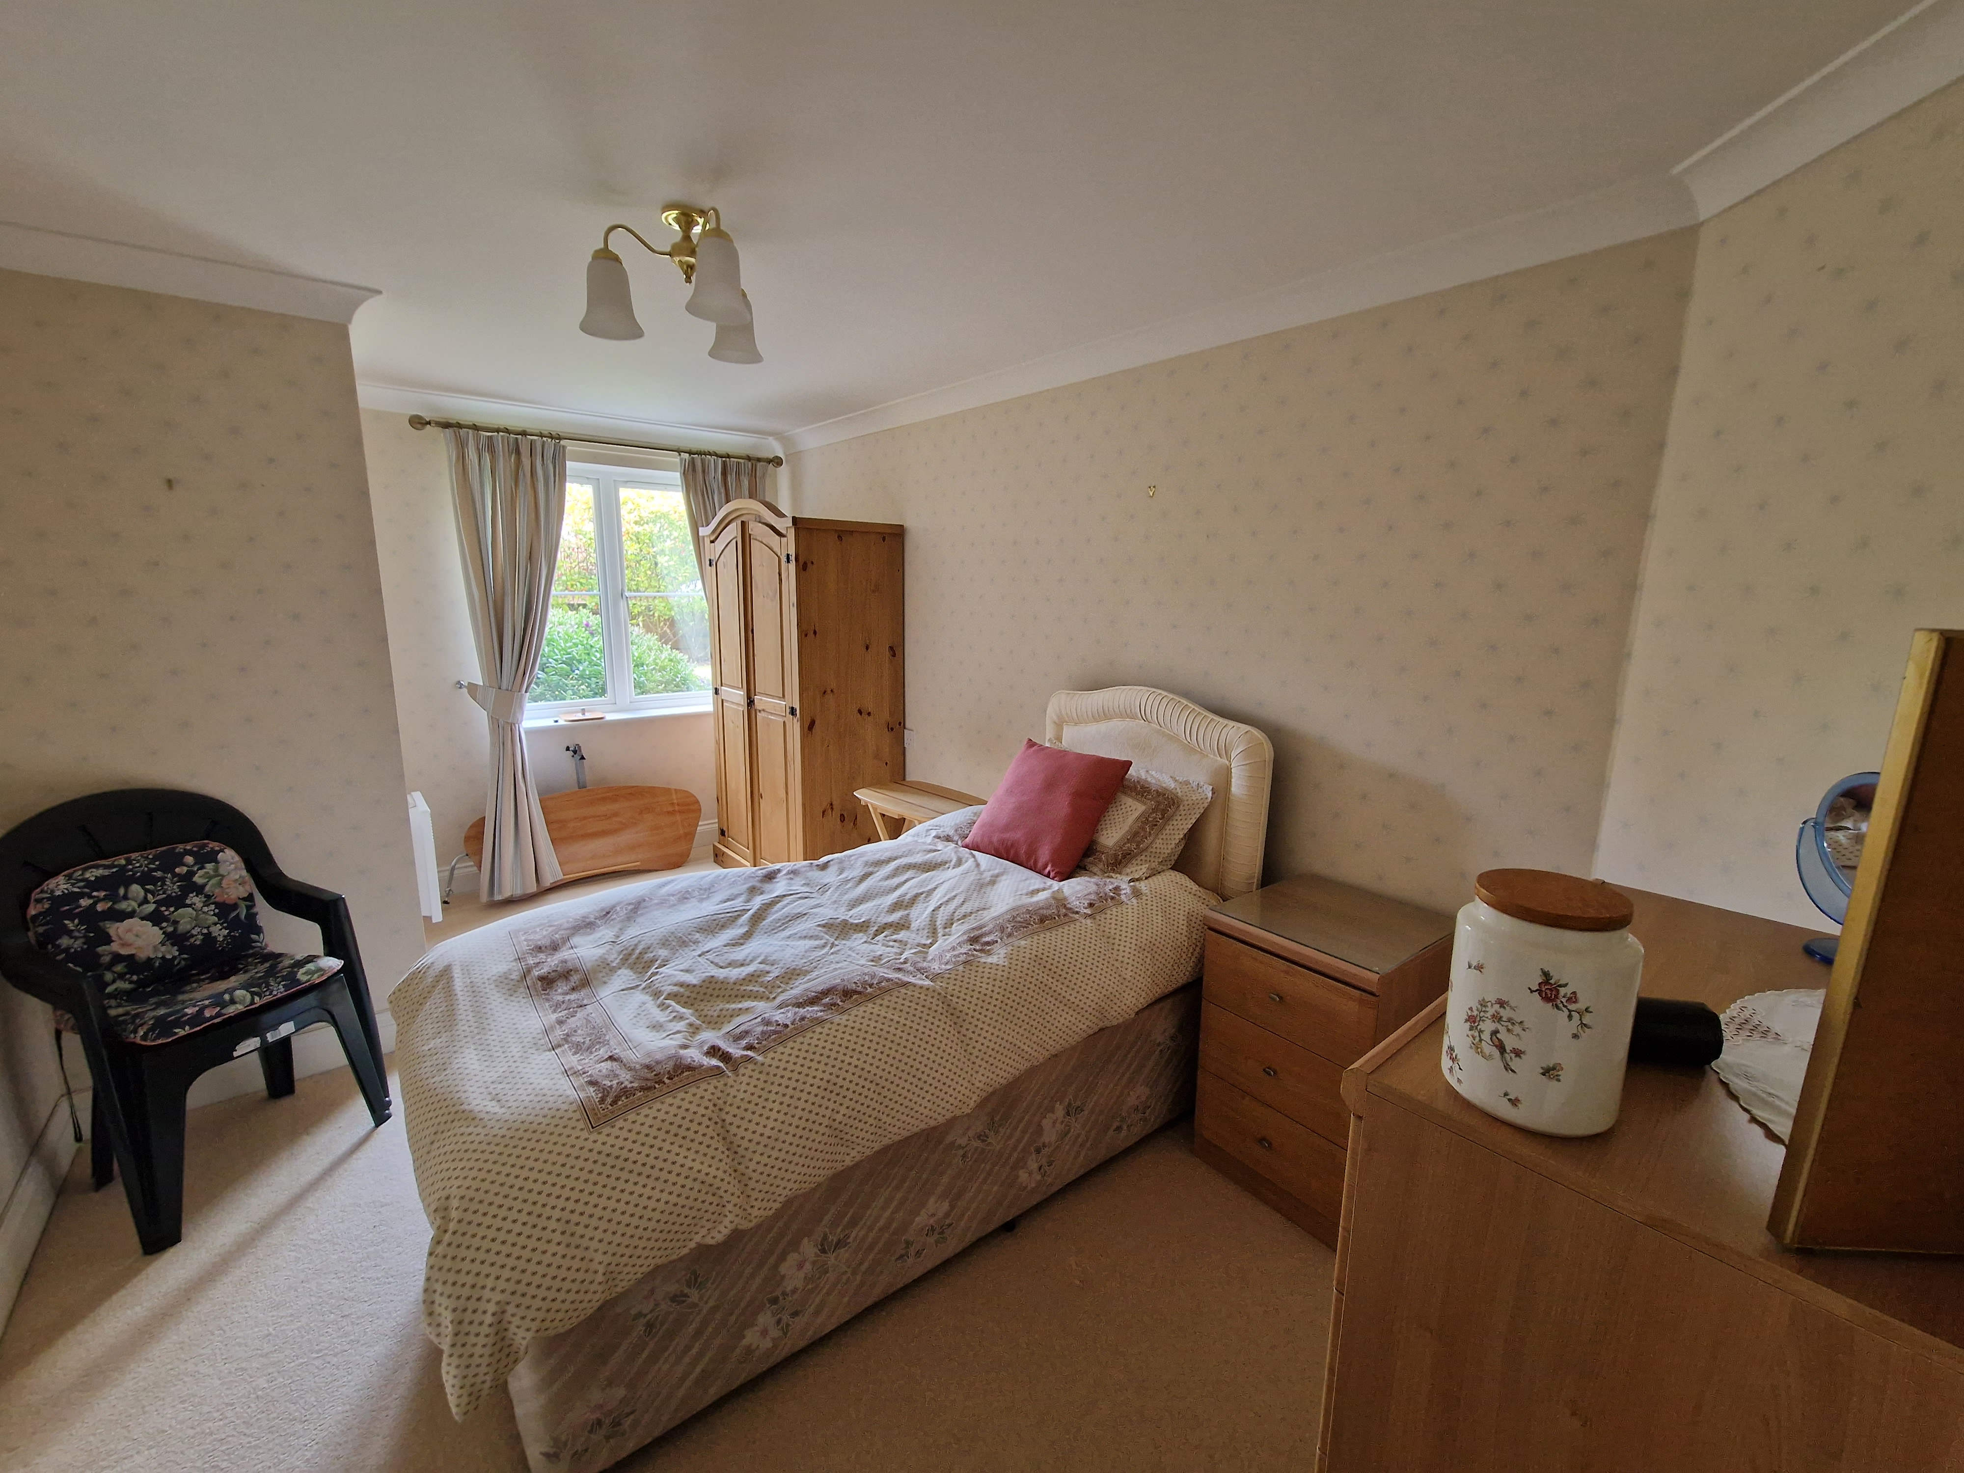
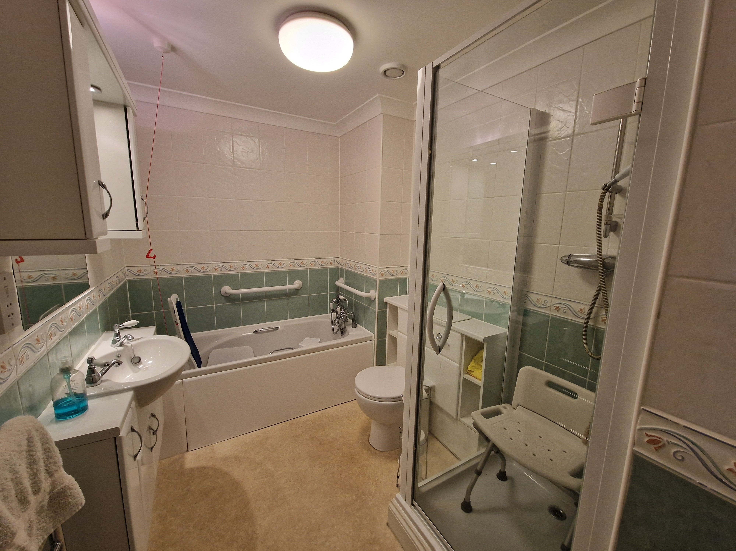
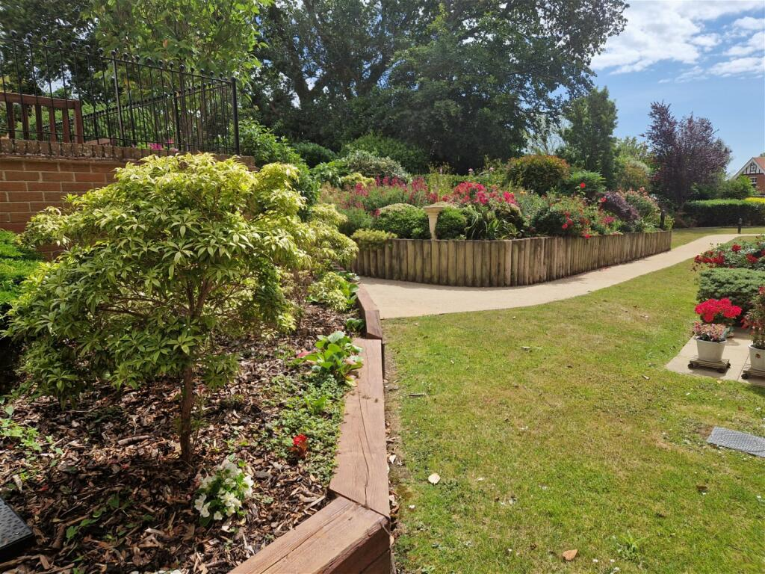
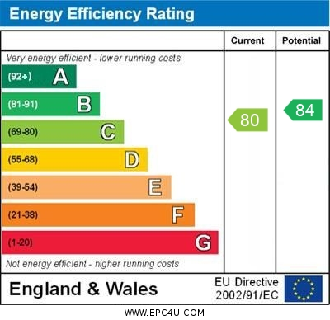
www.pennys.net
3 Pegasus Court, Salterton Road, Exmouth, EX8 2NN
GUIDE PRICE £170,000
TENURE Leasehold
A Superior Two Double Bedroom Ground Floor Apartment Located Within A Highly Desirable Retirement Development
Superior Ground Floor Retirement Apartment * Conveniently Situated Close To The Lounge And Laundry Room * Two Double Bedrooms * Spacious Lounge/Dining Room * Fitted Kitchen With Integrated Appliances * Bathroom With Bath And Separate Shower Cubicle * Superb Communal Facilities Including Residents Lounge, Well Equipped Laundry And Guest Suite * Delightful Landscaped Communal Gardens * Secure parking Area With Spaces Subject To Availability * No Onward Chain
Pennys Estate Agents Limited for themselves and for the vendor of this property whose agents they are give notice that:- (1) These particulars do not constitute any part of an offer or a contract. (2) All statements contained in these particulars are made without responsibility on the part of Pennys Estate Agents Limited. (3) None of the statements contained in these particulars are to be relied upon as a statement or representation of fact. (4) Any intending purchaser must satisfy himself/herself by inspection or otherwise as to the correctness of each of the statements contained in these particulars. (5) The vendor does not make or give and neither do Pennys Estate Agents Limited nor any person in their employment has any authority to make or give any representation or warranty whatever in relation to this property.
PENNYS ESTATE AGENTS
2 Rolle House, Rolle Street, Exmouth, Devon, EX8 2SN
Tel: 01395 264111 EMail: help@pennys.net

Slide 2
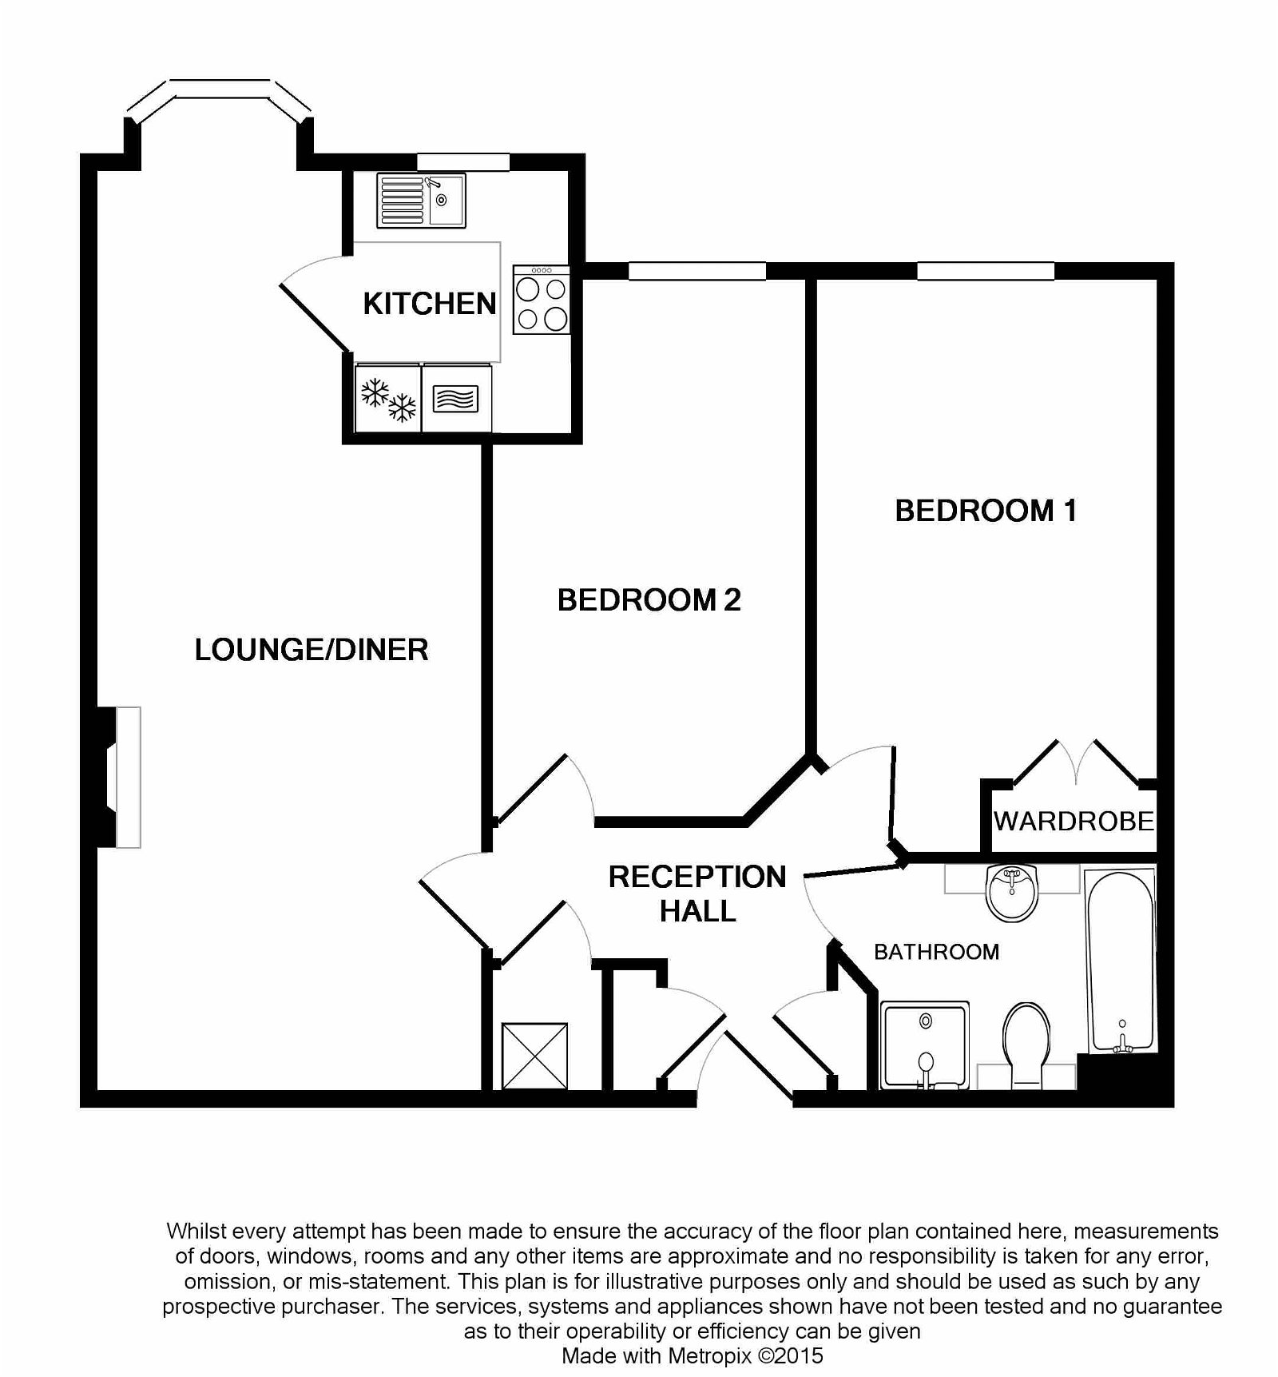
3 Pegasus Court, Salterton Road, Exmouth, EX8 2NN
THE ACCOMMODATION COMPRISES: Communal entrance door with remote entry system leading to:
COMMUNAL HALLWAY: Private entrance door leading to:
RECEPTION HALL: With remote entry system and alarm pull cord; electric panel heater; built in storage cupboard; further built in cloaks cupboard; built in airing cupboard housing water heating system; doors leading to:
LOUNGE/DINING ROOM: 26' maximum plus bay recess x 11' 2" (7.92m x 3.4m) narrowing to 7'1" (2.16m) in the dining area. Double glazed bay window to the front aspect; electric coal affect fire set in attractive surround; two wall light points; television aerial point; telephone point; two electric panel heaters; small pane glazed door leading to:
KITCHEN: 7' 9" x 6' 5" (2.36m x 1.96m) Double glazed window to front aspect; fitted with a modern range of white fronted units comprising single drainer sink unit in roll edge work top surface with tiled splash back; range of base cupboard and drawer units with eye level units over; integrated electric oven; four ring ceramic hob with cooker hood over; further integrated microwave oven and fridge/freezer.
BEDROOM ONE: 16' 3" x 9' 10" (4.95m x 3m) Double glazed window to front aspect; electric panel heater; telephone point; built in wardrobe/storage cupboard.
BEDROOM TWO: 15' 3" x 9' 2" (4.65m x 2.79m) Double glazed window to front aspect; electric panel heater; telephone point.
BATHROOM/SHOWER ROOM/WC: A well-appointed room fitted with a modern white suite comprising panelled bath with antique style shower mixer tap; wash hand basin with storage cupboards below; wall mounted mirror and lighting plinth over; shaver point; close coupled WC with concealed cistern; separate glazed cubicle with built in shower; extractor fan; attractive ceramic wall tiling; alarm pull cord; electric heated towel rail; further wall mounted electric wall heater.
COMMUNAL AREAS: Worthy of special note with a most attractive communal lounge; spacious laundry room; quality visitor suite; library and superb communal gardens. There is an age restriction on the development, and residents must be aged 60 years or over.
OUTSIDE: The property enjoys superb communal landscaped gardens offering an array of colour with a gazebo and various seating areas. There is also a secure parking area with parking spaces subject to availability. Charging point for mobility scooter.
TENURE AND OUTGOINGS: To be confirmed.
FLOOR PLAN:

